Slide 1



TEAM 10
Phish'N'Chips
Integrating EPSS-Based Vulnerability Risk Prediction with Genetic-Algorithm Scheduling for Enterprise Patch Management

Slide 2
The Problem
Modern enterprises face a critical challenge in patch management: deciding when and in which order vulnerabilities should be patched.
Traditional approaches rely on:
Static severity scores such as CVSS
Manual prioritization by security teams
Heuristics that do not scale with system complexity
This leads to three major problems:
Misallocation of resources, where low-risk patches consume time before high-risk ones
Violation of operational constraints, such as maintenance windows, team availability, and environment dependencies
Increased exposure to real-world exploitation, even when patches are technically available
In large infrastructures, patch scheduling becomes a combinatorial optimization problem that is infeasible to solve manually or with simple rule-based systems.

Slide 3
Market Potential
Cybersecurity patch management is a core operational need for:
Enterprises with large IT infrastructures
Critical sectors such as finance, healthcare, energy, and government
Organizations under strict compliance and SLA requirements
As threat landscapes evolve faster, there is a growing demand for:
Risk-aware decision support systems
Automation combined with explainability
Optimization techniques that respect real operational constraints
This problem is not limited to cybersecurity. The same decision model applies to:
Maintenance scheduling
Resource allocation
Risk-based planning problems
Making this solution highly transferable and scalable.

Slide 4
Our Solution Overview
We propose an intelligent decision-support system
That integrates:
Trained EPSS-based risk prediction, estimating the real-world likelihood of vulnerability exploitation
Genetic Algorithms, used to explore optimal patch execution sequences
A deterministic Smart Greedy Decoder, ensuring that every solution:
Respects task dependencies (e.g. UAT before PROD)
Obeys time, team, and environment constraints
Produces a valid and executable schedule
Instead of asking:
“Which patch is more severe?”
Our system answers:
“What is the best patching plan, given risk, constraints, and limited resources?”
The result:
Reduced exposure to high-risk vulnerabilities
Better use of operational capacity
Transparent and explainable scheduling decisions
Impact
This transforms patch management from a reactive process into a data-driven planning and optimization problem.

Slide 5
Our Solution Overview
We propose an intelligent decision-support system
Machine Learning
Planning
User Interface
We use EPSS-based machine learning to estimate the real probability of vulnerability exploitation, moving beyond static severity scores.
Patching is modeled as a constrained planning problem, solved with Genetic Algorithms to produce an optimized and executable patch schedule.
A simple decision-support UI presents the plan, explains priorities, and allows what-if analysis for human validation.

Slide 6
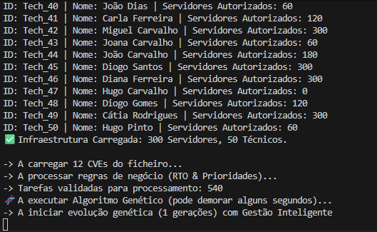
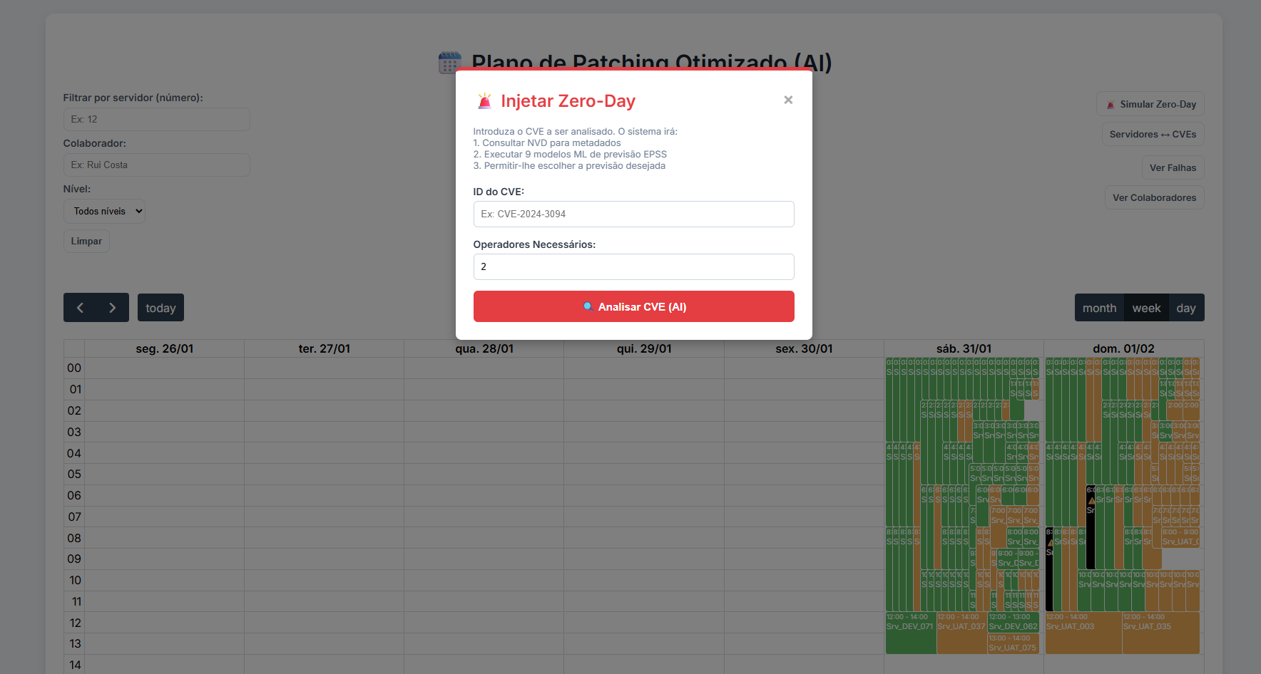
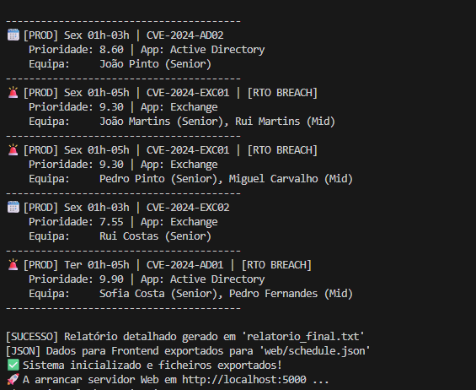
Our Solution Overview
Integrating EPSS-Based Vulnerability Risk Prediction with Genetic-Algorithm Scheduling for Enterprise Patch Management
Let’s see it in action

Slide 7


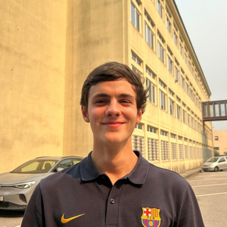


Team 10
Arsénio Ferraz
Entrepreneur, Co-CEO
César Vieira
1241523@isep.ipp.pt
1010137@isep.ipp.pt
Rui Soares
Mário João
1221283@isep.ipp.pt
1221019@isep.ipp.pt
Gonçalo Jesus
1220822@isep.ipp.pt

Slide 8
Team 10
THANK YOU!
“Reducing cyber risk through intelligent planning — beyond severity, beyond intuition.
For more details, visit our blog at Phish-N-Chips25.github.io
– there you will find demos, source code, and additional materials

